Slide 1
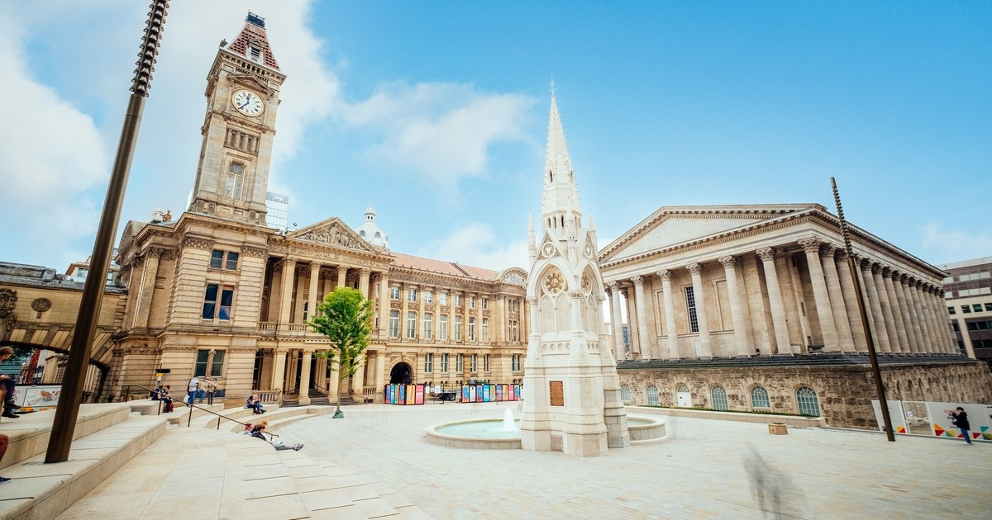
West Midlands Growth Company
Current State Analysis
OCO Global & Metro Dynamics
June 2023

Slide 2
Contents
1 | Literature Review – Trade | 3
2 | Literature Review – Investment | 10
3 | Literature Review – Innovation | 19
4 | Literature Review – Visitor Economy | 28

Slide 3
01 - Trade

Slide 4
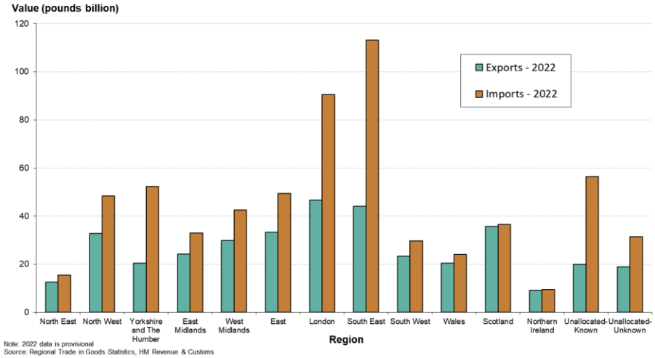
Literature Review – Trade
Current literature covers recent trade statistics up to Q4 2022. It explores recent trade disruptions in the UK describing international and domestic issues, with a focus on the EU-UK TCA agreement.
UK and Regional Trade Statistics
Since 2021, the West Midlands (Wider Region) total value in goods exports increased by nearly £4.4bn (+17.1%) to £29.9bn in 2022.
However, the overall value of UK trade in goods exports increased at a greater rate, by 19.2% (to £371.5bn in 2022).
In 2022, the West Midlands region exported nearly £29.9bn and imported £42.6bn worth of goods, leading to a trade in goods deficit of £12.7bn.
The West Midlands region accounted for 8.0% of UK total exports in 2022. The West Midlands region accounted for 7.0% of UK exports to the EU and 9.2% for Non-EU locations.
Top Sector and Location
In 2022, the largest value goods exported for a SITC section in the West Midlands was machinery & transport at nearly £20.1bn. This SITC section accounted for 67.1% of the total exports value, of which 60.9% (£12.2bn) were non-EU exports.
At a Country Group level, the highest value of West Midlands goods exports was to the EU at nearly £13.6bn, accounting for 45.4% of the total in 2022. Exports to the EU from the West Midlands increased by over £1.8bn (+15.5%) since 2021 – below the UK-wide growth rate (+25.6%).
The value of goods exported and imported by region for 2022 (£ billion)
Source: WMCA Document – EIU Black Country Consortium, UK Regional Trade in Goods Statistics: West Midlands, Year to Q4 2022

Slide 5
Literature Review – Trade
Current literature covers explores recent trade disruptions affecting the the UK describing international and domestic issues, with a focus on the EU-UK TCA agreement.
Recent Trade Disruptions – a view from 2020
Headwinds for West Midlands exporters include the Covid-19 pandemic, supply chain bottlenecks, technological change in the automotive industry (batteries), high energy prices, inflation, as well as the Ukraine war have hit demand.
The West Midlands has been among the hardest hit regions in trade terms in the UK throughout the recent crisis period. The West Midlands’ total exports in 2020 (£25 billion) was three-quarters of that in 2019 (£33 billion), according to the latest ONS UK Trade subnational statistics.
Manufacturing exports shrank by more than a quarter during the same period, the worst decline among all regions.
Similarly, exports in services from the West Midlands also fell by more than a quarter in 2020 (£11 billion) compared to 2019 (£15 billion), the worst decline among UK regions.
Birmingham, which was the top services exporter in the West Midlands, saw the sharpest decline in exporting to the EU in 2020. Emerging regional trade data for exports in goods in 2021, meanwhile, suggest that the recovery of the Midlands area has been more moderate than other parts of the country.
EU-UK TCA
Despite the tariff-free terms of trade in goods set out in the EU-UK Trade and Cooperation Agreement (TCA), UK exports experienced a statistically significant decline once the TCA was put in force. The non-tariff measures (NTMs) put in place as part of the agreement are the main problem, accounting for 70% of the reduction in trade.
It was found that the EU-UK Trade and Cooperation Agreement (TCA) had a strong, negative, and significant impact on UK bilateral trade with the EU countries, leading to 22% reduction in exports and a 26% reduction in imports.
UK trade with non-EU countries has not been significantly affected.
The increased trade frictions due to sanitary and phytosanitary (SPS) and technical barriers to trade (TBT) measures as a result of entering the TCA played an important role in the decline of UK exports to the EU.
Evidence suggests that exporting to the EU has become much more costly, and for some exporters it has become unviable – leading to them dropping out of the market altogether.
Exploring markets outside the EU, notably in Commonwealth countries and emerging economies, as well as some under-explored markets in North America is required.
Source: WMCA Document – International Trade: Frictions, Disruptions and Future Growth, Aston Business School; Enterprise Research Centre - TCA, Non-tariff Measures and UK Trade, June 2022

Slide 6
Literature Review – Trade
Existing West Midlands trade analysis also describes the wider Midlands Engine productivity gap with Birmingham City Centre in particular underperforming - as well as potential solutions.
Discussion on UK Productivity
Exporting businesses are disproportionately responsible for productivity growth. Between 1990 and 2017, productivity more than doubled in the manufacture of computer and electrical equipment and information and communications and tripled in chemicals and pharmaceuticals. By way of contrast, it increased by just 2% in accommodation and food services and declined in arts, entertainment, and recreational services.
Centre for Cities’ estimates suggest the Midlands Engine economy is £18 billion per year smaller than it should be, and 89% of this gap is the result of the underperformance of its urban economies.
The Birmingham conurbation itself underperforms by £10.5 billion every year, about 58% of the total underperformance of the Midlands Engine. (see graph adjacent).
Although Midlands Engine cities and large towns are high-skilled economies compared to surrounding areas, the implication is that they are not attracting enough higher-productivity service exporters.
Solutions include:
Improving the skills of residents.
Making city centres more attractive places to do business.
Improving public transport infrastructure and density within the big cities to achieve agglomeration effects.
Source: Centre for Cities - All cylinders The role of the Midlands Engine in the British economy, May 2023

Slide 7
Literature Review – Trade
West Midlands trade information also describes the wider Midlands Engine productivity gap focused on Birmingham City centre and a discussion on encouraging city centre based services exporters.
Discussion on UK Productivity
As a city centre gets bigger, the share of jobs that are in high-skilled occupations increases. Notably, Birmingham sits on the trend line.
However, Birmingham’s urban area is almost three times the size of Leeds in terms of population.
However, the city centre economies of both cities are very similar in size. This shows that though Birmingham city centre is successful, it is much smaller than it should be.
This limits the prosperity it generates and the contribution it makes to the wider Midlands Engine economy.
The productivity of service exports in the Midlands Engine, although is comparable to manufacturing at £70,700 per worker, is considerably lower than the British average of £92,700. Unlike manufacturing, no city or large town has an service export sector more productive than the country as a whole.
Birmingham is encouraged to focus on growing strong city centre based services exporters especially as the new economy is disproportionately based in cities, and city centres in particular.
Source: Centre for Cities - All cylinders The role of the Midlands Engine in the British economy, May 2023

Slide 8
Literature Review – Trade
West Midlands trade information also describes the wider Midlands Engine productivity gap as well as potential solutions. Potential Gaps in the supplied literature are identified by OCO.
UK- India Trade Deal
The distribution of gains across the country suggests that all nations and regions could see an increase in output from a UK – India FTA. An expansion in motor vehicle related production could drive larger expansions in the West Midlands in a deeper agreement (equivalent to £297 million on the same basis).
Indian-owned businesses employ UK workers in every region of the UK. In 2019, there were over 1,000 Indian-owned local business units operating in the UK, employing more than 95,000 people, with the most people employed in the West Midlands (29,200 people), followed by London (20,700) and Wales (10,700).
Potential Gaps in Supplied Literature
Current Analysis covers Regional data but not City Regional data.
Comparison is with other regions – not city regions which is available.
Current Analysis in Trade and disruption only covers up to 2020 – more up to date data could or should be found.
Current analysis does not highlight or prioritize which countries should be targeted for exports and why.
Trade data is light on looking at services exports especially as this has been highlighted as a major growth opportunity.
Source: Department for International Trade - UK-India Free Trade Agreement The UK’s Strategic Approach, January 2022

Slide 9
Literature Review – Trade
The West Midlands Local Industrial Strategy highlighted key sector strengths, and how the West Midlands might improve upon them.
West Midlands Local Industrial Strategy
This Local Industrial Strategy demonstrates how the West Midlands is forging its future and building an inclusive and balanced economy. Together with the supporting documents published locally, it shows the West Midlands is taking action to continue growth in productivity and earning power for all.
Building on its distinctive strengths – from transport innovation to data driven health and life sciences and globally competitive supply chain firms – this Local Industrial Strategy sets out the steps the West Midlands will take to:
Drive growth by strengthening the foundations of productivity; contributing towards the Grand Challenges; and taking advantage of market driven opportunities in mobility, data-driven health and life sciences, modern services, creative content, techniques and technologies; and
Ensure all communities can contribute to and benefit from economic prosperity whilst protecting and enhancing the environment; investing further in social infrastructure; measuring progress; and
Designing actions using a balanced set of inclusive indicators.
Identified Sector Strengths Include:
Source: Centre for Cities - All cylinders The role of the Midlands Engine in the British economy, May 2023

Slide 10
02 - Investment

Slide 11
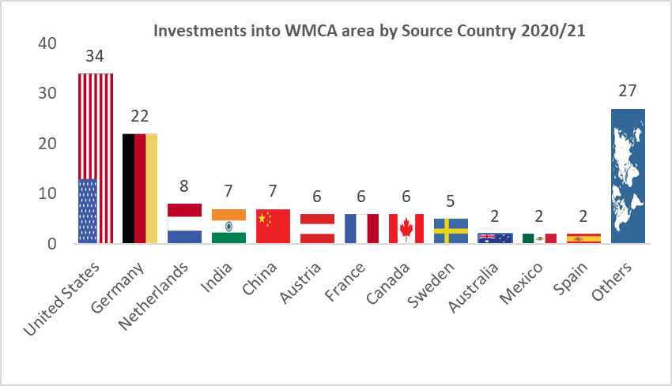
Literature Review – Investment
FDI into the West Midlands has been strong looking at the past track record. Generally the region punches above its weight outperforming other regions that have more available resources for FDI attraction.
FDI into the West Midlands has been historically strong
Historically the UK has been a strong performer in terms of FDI attraction and within the UK the West Midlands punches above its weight as a region – out performing areas such as the Scotland, the North West and Northern Ireland which have access to higher levels of government and other public sector resources.
More recent DIT/WMGC analysis, meanwhile, indicates that in 2020-21 the West Midlands attracted 136 FDI projects (the most of any UK nation or region outside London and the South East), bringing in £9.5 million of investment and creating more than 7,500 new jobs.
Encouragingly almost two thirds of these projects were in the priority sectors identified in the West Midlands Local Industrial Strategy (WMLIS) – advanced engineering and future mobility, tech and creative, data driven healthcare and life sciences and modern business services. While the largest source of projects was long standing markets such as the US and Germany, encouragingly many came from new emerging markets such as China and commonwealth countries targeted by the Commonwealth Games Business and Tourism Programme such as India, Canada and Australia.
Source: April 2022 QED Article - WBS - making the most of the region's FDI success FINAL DRAFT

Slide 12
Literature Review – Investment
Analysis of FDI into the West Midland Combined Authority has focused on the Business and Tourism Programme launched in conjunction with activities surrounding the Commonwealth Games.
Attracting FDI - Modern Business Services
The WMCA has seen the arrival of US/Irish professional services multinational Accenture, creating 500 new jobs in Birmingham and the expansion of Indian financial services giant FirstSource – adding 200 new employees to its 300 strong existing workforce in support of two UK retail banking clients. These investments come hot on the heels of the attraction of Goldman Sachs’ technical engineering headquarters, HSBC’s UK consumer bank headquarters, and Market leaders such as KPMG, Deutsche Bank, PwC and BT are also growing strong.
Attracting FDI – Future Mobility
Looking at Future Mobility, the data for the UK show that the West Midlands has outperformed all other UK regions in terms of inward investment performance, with 15% of the UK total. This reflects the regions role as a global centre of automotive R&D, with a growing specialism in emerging future mobility technologies such as electric vehicles, battery technology and alternative fuels via the UK Battery Industrialisation Centre, the Future Power Systems Research group, the Centre of Hydrogen and Fuel Cell Research, and the Centre for Advanced Low Carbon Propulsion Systems.
Source: FDI attraction – benchmarking the region against our competitors

Slide 13
Literature Review – Investment
Analysis of FDI into the West Midland Combined Authority has focused on the Business and Tourism Programme launched in conjunction with activities surrounding the Commonwealth Games.
Attracting FDI – Digital and Creative Technologies
The West Midlands is in 6th place among the 11 regions in terms of the amount of investment attracted over the 2013-2021 period and the region is a significant way behind other leading global destination regions for D&CT investment. There was a strong upsurge in DCT investment projects landing in in 2018 and 2019, which coincides with the establishment of the UK’s first 5G testbed in the region. Recent examples include investment firm Goldman Sachs’ tech engineering centre creating 550 jobs and the UKHQ of Advanced Software creating 500 jobs.
Attracting FDI - Data Driven Healthcare
The West Midlands punches above its economic weight, attracting the 5th highest number of data driven healthcare (DDH) projects of any UK region over the 2013-2021 period. While DDH projects are often challenging to attract due to the sometimes considerable R&D and equipment costs involved, looking back over recent decades the West Midlands has been successful in attracting investment from the likes of German optical equipment specialist Carl Zeiss, Swiss hospital facilities supplier giant Vamed, Swedish-owned BioSite and US-based HCA Healthcare.
Source: FDI attraction – benchmarking the region against our competitors

Slide 14
Literature Review – Investment
The Integrated Review set the UK's overarching national security and international strategy, bringing together defence, security, resilience, diplomacy, development and trade, as well as elements of economic, and science and technology policy.
Global Britain – Integrated Review
The Integrated Review document is intended as a guide for action for those responsible for aspects of national security and international policy across government, including in departments that would not previously have been considered part of the national security community.
This publication sets out the principal conclusions of the Integrated Review. It comprises:
The Prime Minister’s vision for the UK in 2030, from which the other outputs of the Integrated Review flow.
The Government’s current assessment of the major trends that will shape the national security and international environment to 2030.
A Strategic Framework that establishes the Government’s overarching national security and international policy objectives, with priority actions, to 2025.
An outline of the approach we will take to implementing the Strategic Framework.
A list of Spending Review (SR) 2020 decisions that support the Integrated Review, and a description of our use of evidence and the programme of domestic and international engagement which supported our work.
The document is intended as a guide for action for those responsible for aspects of
national security and international policy across government, including in departments that would not previously have been considered part of the national security community.
The US is the UK’s biggest single bilateral trading partner, accounting for over £230 billion in trade, almost 20% of UK exports and the largest single source of FDI in 2019. We will seek to grow this further through an FTA, which will help both our economic recoveries from COVID-19 and aid our shared ambition to level up, setting a new bar for trade deals of the future in digital trade, in the protection of intellectual property and in accelerating efforts on the low-carbon economy. We will also seek closer collaboration in tackling illicit finance.
Indo-Pacific is the world’s growth engine: home to half the world’s people; 40% of global GDP; some of the fastestgrowing economies; at the forefront of new global trade arrangements; leading and adopting digital and technological innovation and standards; investing strongly in renewables and green tech; and vital to our goals for investment and resilient supply chains. The IndoPacific already accounts for 17.5% of UK global trade and 10% of inward FDI and we will work to build this further, including through new trade agreements, dialogues and deeper partnerships in science, technology and data.

Slide 15
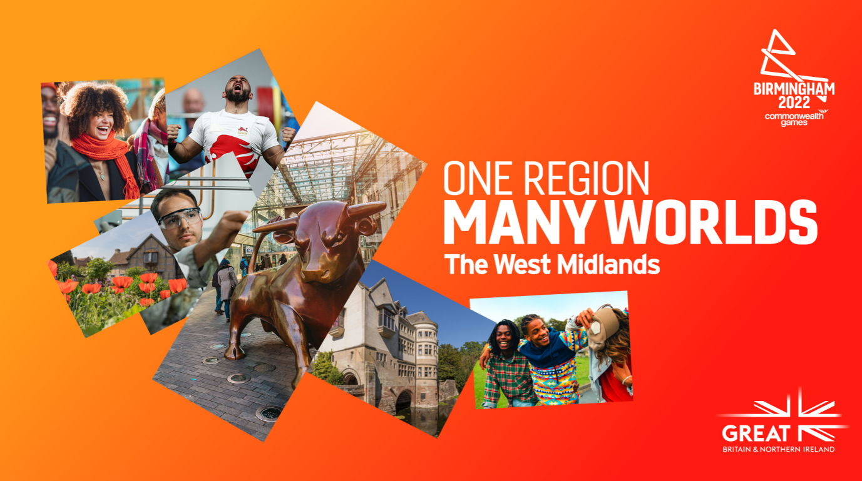
Literature Review – Investment
The Business and Tourism Programme (BATP) leveraged the profile generated by the Games to boost the region’s global reputation as a leading destination for tourism, trade, and investment.
Business and Tourism Programme (Commonwealth Games)
The Business and Tourism Programme (BATP) aims to leverage the Birmingham 2022 Commonwealth Games to embed positive perceptions of the West Midlands into the international imagination, driving long-term economic benefits across the region, fostering civic pride.
Focusing on tourism, trade and investment, the three-year programme will catalyse the West Midlands’ growth strategy, cementing the region, and wider UK, as a globally sought-after location to visit, invest and live in.
Programme benefits
The BATP will operate until late 2023, but the benefits of the programme are expected to last long-term, until 2027 and beyond. The programme is designed to secure more than £650 million of new overseas investment into the UK and create £7 million of additional export deals until 2027. Contributing to over one million visits to the Games, BATP is also expected to attract thousands of additional visitors to the region and UK until 2027, generating millions in visitor spend.
Programme objectives
Investment (inward investment and capital attraction): To attract more inward and capital investment from Commonwealth sources to the UK and the West Midlands.
Trade: To build capacity and capability among businesses to export to the Commonwealth, and BATP target markets, in particular.

Slide 16
Literature Review – Investment
The West Midland’s economic positioning has eroded, due to a combination of the Covid pandemic, Brexit disruption and supply chain difficulties. The West Midlands Plan for aims to return the area to growth, spreading opportunity and jobs across the region and helping level-up the UK.
West Midlands Plan for Growth
A combination of the Covid pandemic, Brexit disruption and supply chain difficulties have had a disproportionate effect on the region due to its industrial base.
The region’s response is to come together and pinpoint those precise clusters and technologies that can shift the West Midlands into the next gear of economic recovery, with benefits felt across the region generating greater consumer confidence and spending.
The West Midlands Plan for Growth builds upon the region’s Strategic Economic Plan and Local Industrial Strategy which capture the key features of the West Midlands economy, including our geographical connectivity, our young and diverse population, our skills profile and business productivity.
New trade deals are being struck across the globe opening markets for West Midlands’ business and creating the conditions to bring foreign direct investors to the West Midlands. Therefore the West Midlands Plan for Growth has a focus on business location coordination and foreign direct investment.
Business location coordination and foreign direct investment
Individual actions in the West Midlands Plan for Growth include:
Delivery of the £23 million Business and Tourism Programme. Led by the West Midlands Growth Company, the Programme capitalises on the global buzz created by the Commonwealth Games to secure more than £650 million of new overseas investment into the UK, and create £7 million of additional export deals by 2027, in priority sectors that align with the Plan for Growth clusters.
Securing gear-shift private investment through the West Midlands Investment Prospectus. The prospectus covers some £20 billion of housing, commercial and industrial projects right across the region and was launched at MIPIM in Cannes in March 2022. The UK Real Estate Investment and Infrastructure Forum in May 2022 saw the launch of the West Midlands’ ground-breaking £4 billion partnership with L&G on a seven-year programme to use private investment to help the region level up.
Pursuing ambitious further powers and resources from Government through the Trailblazing Devolution Deal for the “Global West Midlands” plan. Its intention is to extend the Business and Tourism Programme’s reach and duration by co-designing and co-delivering an Internationalisation Strategy with Government.
Source: West Midlands Combined Authority – West Midlands Plan for Growth

Slide 17
Literature Review – Investment
The West Midlands (Combined Authority) is receiving new powers covering further control in housing, transport, employment and regeneration announced in a Budget deal estimated to be worth more than £1.5bn.
West Midlands - Deeper Devolution Deal
The West Midlands is embarking on a new phase of devolution by bringing greater investment, control over investment and powers to the region. This landmark deal, estimated to be worth in the region of £1.5bn, will reboot the economy, provide vital housing, jobs and skills, bolster our existing strengths in transport and Smart City Region innovation, and drive our net zero ambitions – generating economic growth and levelling up outcomes for all residents and communities.
In February 2022, Government announced, in its Levelling Up White Paper, new devolution deals for the West Midlands, along with Greater Manchester. Since then, the region and its partners have been working closely with Government to secure the best deal for the region, its economy and its communities.
With greater powers comes greater accountability, and Government has set out its expectations around the measures the region should put in place to receive this new, Deeper Devolution Deal. It will be held accountable through the Local Government Accountability Framework, English Devolution Accountability Framework and enhanced scrutiny measures. In addition, the Mayor and WMCA will be expected to present to Parliamentary Select Committees as requested, in conjunction with Mayor’s Question Time and quarterly engagement with West Midlands MPs.
New Powers include:
The Deeper Devolution Deal will maximise the WMCA’s current role and responsibilities and revolutionise how Government funding is implemented – providing the tools to deliver more inclusive growth.
A commitment towards a Single Funding Settlement, where for the first time, a region will be treated as if it were a government department, enabling the region to prioritise, target and decide how funding is spent in key areas from the next spending review onwards.
A landmark housing deal worth up to £500 million – with flexibilities around deployment for regenerating brownfield land, a route to full devolution of Affordable Housing Programme funding, and the West Midlands leading a pioneering new approach to maximising Government land assets
Fiscal devolution, including committed 10-year retention of business rates – worth an estimated £45 million a year to the WMCA and its partner authorities.
The ability to designate Levelling Up Zones – priority areas identified jointly by the WMCA and its partner authorities that will attract 25-year business rates retention, to accelerate growth, development and regeneration.
Commitment to devolving retrofit funding (from 2025)
Empowering the region’s transport transformation through devolution of bus service operator grants and a new partnership with Great British Railways.
Source: West Midlands Combined Authority – West Midlands Plan for Growth

Slide 18
Literature Review – Investment
Looking Forward the West Midlands Investment Strategy will be built around Global West Midlands.
Looking Forward - Global West Midlands
Looking Forward the West Midlands Investment Strategy will be built around Global West Midlands.
Interacting with national priorities the West Midlands proposals will notably, attracting and retaining inward investment, supporting UK businesses to take full advantage of trade opportunities, global marketing of UK regions as tourist destinations, winning more international business events, and extending the season and length of stay for both domestic and international visitors.
To achieve this, The West Midlands propose that:
They co-design with Government a West Midlands Internationalisation Strategy to deliver regional and national priorities, with the West Midlands Growth Company formally recognised as the de facto lead agency for Trade and Investment across the West Midlands;
The Department for Business and Trade (DBT) to become a shareholder of the West Midlands Growth Company alongside WMCA, 7 local authorities and universities;
They implement the recommendations of the De Bois Review into destination management organisations;
Create a new regionally administered investment incentive fund drawn from the global Britain Investment Fund;
Deepen and formalise the relationship between the Office for Investment and West Midlands on capital investment outcomes;
Secure additional investment for the internationalisation of the Plan for Growth
Potential Gaps in Supplied Literature
Investment planning is relatively comprehensive in the available literature and planning.
Current information does not explore potential new source markets and linkages between the West Midlands and external economies.
Linkages exist between the UK investment strategies and the West Midlands offer, but this could be strengthened.

Slide 19
03 - Innovation

Slide 20
Literature Review – Innovation
A Centre for Cities event noted that challenges remain in unlocking the power of the West Midlands innovation system, including the imbalance in R&D investment and barriers to SME growth
How can innovation drive growth in the West Midlands?
A Centre for Cities’ Realising Regional Growth event in July 2022 brought together Lord Sainsbury and West Midlands Mayor Andy Street, alongside other local leaders, to discuss the city-region’s economy.
Manufacturing remains an integral part of the city region’s economy, but it is the high-value add jobs in knowledge intensive business services which will drive future economic growth.
Challenges remain in unlocking the power of the West Mids innovation system, including the imbalance in R&D investment and barriers to SME growth
Whilst all panellists agreed that innovation is key to the region’s growth and prosperity, several structural issues with West Midlands’ innovation system were highlighted by speakers.
Dr Pam Waddell, Director of the West Midlands Innovation Alliance, noted that there is a “huge imbalance in West Midlands’ innovation ecosystem”. With low public sector investment in R&D and high private sector investment, with the latter being “deep but narrow” in the fields of manufacturing and engineering.
The priority should therefore be expanding business investment into other sectors, such as cleantech, healthtech and medtech. Meanwhile central government must deliver on its pledge to increase R&D investment to 2.4% of GDP by 2027.
The Mayor, who discussed how public R&D funding is concentrated in the Greater South East, and that his “single biggest ask of government” would be to increase this, as otherwise the current “tiny [public] investment” would continue to severely hinder SMEs in the city region.
Waddell added that innovation needs a market for it to be commercialised, so businesses will only thrive if they identify markets for their products and processes, and that SMEs in West Midlands should focus more on “exploiting R&D assets to turn into innovation”.
Therefore, places across the city region must identify and establish their competitive advantages
Potential Gaps in Supplied Literature
text
Source: Centre for Cities: Realising Regional Growth: What next for the West Midlands?

Slide 21
Literature Review – Innovation
Existing literature took a high level view of innovation in the region with a range of positive statistics and challenge points, including R&D investment capacity, VC Investment, and specialized university expertise.
Existing literature has a high level view of innovation in the West Midlands
The West Midlands has a long history of outstanding innovation generated by both its business and Universities, with numerous examples of world class innovations in specific areas of specialism such as advanced manufacturing, precision engineering and gaming.
R&D investment capacity. In 2021 the West Midlands ranked 11th in Europe for total private R&D investment among regions containing a major city, ahead of Amsterdam, Düsseldorf and Hamburg.
VC investment. In the 5 years to 2022 the region attracted nearly $500m of VC investment, with more than half going to firms outside Birmingham.
Specialised university expertise. There are 2 West Midlands universities in the UK top 20 for research excellence, with 34% of regional research considered world-leading in terms of originality, significance and rigour.
Talent pipeline. Five of the region’s nine universities are in the top 1,000 globally, putting it second in the world among mid-sized city regions – and are essential components in attracting and developing more students combined than in any other region of its size globally.
Innovation ecosystem. With HS2 unlocking a new innovation cluster around Arden Cross, the West Midlands is one of ten non-capital European city regions that are home to the full recognised suite of innovation-rich investment locations – urban innovation districts, R&D led campuses, industry hubs, and re-animated science & business parks.
Digital infrastructure. Launched in 2020, 5PRING built on the West Midlands’ early adoption of 5G technology to become the UK’s first 5G commercial application accelerator. The West Midlands now has stronger mobile connectivity on average than Milan, Hamburg and Helsinki.
And, critically, the frequency of collaboration between universities and businesses. There is a vibrant innovation ecosystem within the West Midlands, with prominent examples including:
The West Midlands Innovation Programme seeks to aid the innovation process via, for example, business networks, incubator facilities, cross-industry technology transfer, mentoring and grant support and graduate internships
The Energy Research Accelerator, supported by three universities (Birmingham, Warwick & Aston), to solve the energy industry’s most pressing challenges.
Potential Gaps in Supplied Literature
text

Slide 22
Literature Review – Innovation
Existing literature identifies and explore key sectors for the wider Midlands Engine across key Super Clusters. However, some of these super clusters are less relevant for the WMCA.
‘Midlands Engine’ Super Clusters
Super clusters for the wider Midlands Engine were identified, including:
Advanced Manufacturing
Transport Technologies
Digital Technologies and Services
Energy and Materials
Health and Life Sciences
Agri-Food
These super clusters combine at least ten Midlands ‘Established Clusters’, which incorporate significant concentrations of economic activity in multiple locations, linked to sectors of long-established industrial strength within the region.
Further the super clusters incorporate at least fourteen Midlands ‘New Economy Clusters’, which include multiple concentrations of economic activity identified and labelled by partners as aligned to emerging knowledge, technology and innovation-intensive sectors.
This broad and holistic look at the wider East and West Midlands provides analysis for the Midland Engine. However, some super clusters are less relevant for the economic base seen in the West Midlands Combined Authority such as Extractive Industries, Offshore Wind, or Agri-Food.
Source: Midlands Engine – Exploring the Investment Potential of Midlands Clusters – Overview Report

Slide 23
Literature Review – Innovation
Existing literature identifies and explore key sectors for the wider Midlands Engine across key Super Clusters. However, some of these super clusters are less relevant for the WMCA.
‘Midlands Engine’ Super Clusters – Innovation Metrics
Each super cluster is analysed according to the various ecosystem supporting each. Analysis include various data points and supporting information. The four ecosystems analysed for each super sector include:
The business ecosystem
Talent Ecosystem
Investment Ecosystem
Innovation Ecosystem
The Innovation Ecosystem for each super sector includes the following datapoints:
Accelerator Engagement
Relevant Spinouts
Relevant high performing HEI Research
Significant Innovation Hubs
High Growth Company Grants
Innovate UK Funding.
The table adjacent contains these metrics for the Health and Life Sciences Super Cluster in the Midlands Engine.
Innovation Metrics for the Midlands Engine Health and Life Sciences Super Cluster
Source: Midlands Engine – Exploring the Investment Potential of Midlands Clusters – Overview Report

Slide 24
Literature Review – Innovation
Expanding on provided literature new opportunities exist from central government innovation strategies such as the UK Science and Technology Framework, with the goal of raising public investment in R&D by at least 40% outside the greater South-East of England.
UK Science and Technology Framework
The Science and Technology Framework sets out the UK’s approach to making it a “science and technology superpower” by 2030.
It has been developed in close collaboration with the UK science and technology sector, and represents a commitment to scaling its ambition and delivering the most critical actions needed to secure strategic advantage through science and technology. The UK government will have a clear action plan for each strand of the framework in place by summer 2023.
A robust and repeatable approach was used to identify the technologies that are most critical to the UK. 50 technologies across 8 criteria were assessed and a portfolio of 5 critical technologies was identified, including:
Artificial Intelligence (AI)
Engineering biology .
Future telecommunications
Semiconductors
Quantum technologies
The Science and Technology Framework will result in:
Increased private sector investment in R&D, building on record levels of public sector investment committed at SR21. The UK will have delivered the biggest increase in public R&D investment, and have already committed to invest £20 billion in R&D in 2024 to 2025.
Ensuring the UK has the right diversity in the science and technology landscape. Alongside excellent universities, it will optimise existing organisations such as Public Sector Research Establishments and Catapults, and consider new agile, innovative models such as focused research organisations and practical support for innovators.
Raised domestic public investment in R&D, particularly outside the Greater South East by at least 40% as set out in the Levelling Up White Paper, to boost productivity, pay, jobs and living standards across the nation.
Accelerated translation, commercialisation and knowledge exchange through targeted support for local innovation clusters
Reduced bureaucracy of research and innovation funding, with funders experimenting with new approaches. This will build on the Independent Review of UKRI and the Bureaucracy Review, and consider all
Potential Gaps in Supplied Literature
text
Source: UK Science and Technology Framework, 2023

Slide 25
Literature Review – Innovation
Major Innovation related interventions organised through the West Midland Plan for growth include the Early Growth Fund, and the West Midlands Innovation Accelerator.
West Midlands Plan for Growth
Introduced by Mayor Andy street, the West Midlands Plan for Growth is a crosscutting document and plan to deliver clean and inclusive economic growth. The plan aims to help create the conditions for investment and prosperity.
The Plan aims to interact with the Levelling-Up White Paper with the promise to spread opportunity across the United Kingdom, tackle inter- and intra-regional imbalances and succeed in its twelve Missions by 2030. The White Paper gave the West Midlands the chance to secure a ‘Trailblazing Devolution Deal’.
The Combined Authority will deliver conditions for growth through:
New Powers over Economic development
Transport Investment
Housing and land investment, Regeneration
Skills
Working with investors
Net Zero
https://www.wmca.org.uk/media/cjafxkj4/plan-for-growth.pdf
Major Innovation related interventions organised through the West Midland Plan for growth include the:
Early Growth Fund: WMCA has initiated the West Midland Equity Co-Investment Fund. This £25 million fund will invest equity into the region’s high growth potential SMEs and act as a beacon to crowd-in further private investment.
West Midlands Innovation Accelerator: overseen by the West Midlands Innovation Board, where the vision is to double public R&D invested in the region by 2030. Announced in the Levelling-Up White Paper, the West Midlands is one of three Innovation Accelerators nationwide and will see around £33 million invested in the next three years on applied and translational research to spark commercial growth and bolster the region’s R&D capability and capacity.
Potential Gaps in Supplied Literature
text
Source: West Midlands Combined Authority – West Midlands Plan for Growth

Slide 26
Literature Review – Innovation
Major Innovation related interventions organised through the West Midland Plan for growth include the Early Growth Fund, and the West Midlands Innovation Accelerator.
West Midlands Innovation Programme - Early Growth Fund
Historically, the supply of risk capital funding for SMEs in the West Midlands for starting and scaling-up has been poor, with the West Midlands sitting in the bottom quartile for proportion of UK SME deal share and investment share.
The objective is for a larger and more diverse supply of growth capital in the West Midlands, with businesses that are investment ready to use it to generate strong commercial returns. The region is building its critical mass of early growth fund activity to feed those firms with exponential growth potential.
Recognising the constrained supply of growth capital in the West Midlands to accelerate the recovery, the WMCA has initiated the West Midland Equity Co-Investment Fund. This £25 million fund will invest equity into the region’s high growth potential SMEs and act as a beacon to crowd-in further private investment.
Government’s 2021 Spending Review announced a further £400 million for the British Business Bank to invest in growth businesses across the Midlands.
University spinouts often offer rapid growth potential but have a need for significant growth capital. Some of the region’s universities have recognised the opportunity to work together so their pipeline of spinouts has access to major institutional investment and senior leadership experience.
Innovation Accelerator Fund
The West Midlands Innovation Accelerator, overseen by the West Midlands Innovation Board, where the vision is to double public R&D invested in the region by 2030.
Announced in the Levelling-Up White Paper, the West Midlands is one of three Innovation Accelerators nationwide and will see around £33 million invested in the next three years on applied and translational research to spark commercial growth and bolster the region’s R&D capability and capacity.
New ways of working will build relationships to influence spending by UKRI’s research councils and other Government bodies like the National Institute for Health Research. The intent is for Accelerators to help move places from good to great on applied and translational innovation with a strong commercial opportunity.
The Innovation Board has homed in on clusters emphasised in the Plan for Growth - medical and clean technology, modern housing and sustainable construction - as well as practical steps to develop the region’s R&D capacity and capability so the West Midlands reaps the benefits of Government’s additional £5 billion investment in public R&D by 2025 on the path to reaching 2.4% of GDP by 2030
Potential Gaps in Supplied Literature
text
Source: West Midlands Combined Authority – West Midlands Plan for Growth

Slide 27
Literature Review – Innovation
Other major institutional R&D input includes the UK Shared Prosperity Fund, and the Innovation Alliance for the West Midlands.
Other R&D Inputs
Other R&D funds, strategies, and organisations include:
UK Shared Prosperity Fund: The UK Shared Prosperity Fund (UKSPF) is a new three-year fund running from 2022/23 that will replace European Structural and Investment Funds (ESIFs) such as the European Regional Development Fund (ERDF) and the European Social Fund (ESF). The West Midlands Combined Authority (WMCA), as Lead Authority, have been awarded just over £88 million of the UKSPF.
The Innovation Alliance for the West Midlands: This organisation is an alliance of organisations active or interested in science and technology based innovation across the West Midlands. It has two principle objectives, first to build and maintain a thriving innovation ecosystem, and second to stimulate and catalyse a pipeline of innovation activity.
Potential Gaps in Supplied Literature
No comprehensive view of R&D Assets
No comparative Benchmarking with comparative regions in R&D performance
An R&D strategy is forming – lots of additional opportunities with various strands of funding have started
More R&D target sectors may need to be included to lead growth in services exports.
Source: West Midlands Combined Authority – West Midlands Plan for Growth

Slide 28
04 - Visitor Economy

Slide 29
Literature Review – Visitor Economy
Headline
The West Midlands Business and Tourism Programme (BATP)
The Business and Tourism Programme (BATP) aims to leverage the Birmingham 2022 Commonwealth Games to embed positive perceptions of the West Midlands into the international imagination, driving long-term economic benefits across the region, fostering civic pride.
The BATP is the first accredited Commonwealth Games programme of its kind and is being delivered by the West Midlands Growth Company on behalf of the West Midlands Combined Authority (WMCA), alongside the Department Business and Trade (originally DIT) and Visit Britain.
The programme partnership is working closely with the Organising Committee (OC) for the Birmingham 2022 Commonwealth Games, Birmingham City Council, the Commonwealth Games Federation (CGF) and others as a key component of the broader Commonwealth Games programme.
The BATP will operate until late 2023, but the benefits of the programme are expected to last long-term, until 2027 and beyond.
The programme is designed to secure more than £650 million of new overseas investment into the UK, and create £7 million of additional export deals until 2027. Contributing to over one million visits to the Games, BATP is also expected to attract thousands of additional visitors to the region and UK until 2027, generating millions in visitor spend.
Programme Objectives:
Visitor Economy related Programme Objectives include:
Leisure tourism: To attract more international visitors from our BATP target markets and more domestic visitors, in turn boosting the expenditure and jobs supported by the visitor economy.
MICE and sporting events: To boost the UK’s and the region’s profile as a key international conference and event destination, attracting a range of additional major events.
Profile and reputation: To put the West Midlands on the global map, positively shifting perceptions towards the region nationally and overseas, invigorating local pride.
Activity focused on the Commonwealth nations, plus the domestic UK market. BATP aimed to leverage other opportunities that support its objectives, by extending its reach to other overseas markets.

Slide 30
Literature Review – Visitor Economy
Headline
WMCA STEAM Summary Report August 2020
The Economic Impact of the Visitor Economy
This report took a baseline view of the visitor economy in the WMCA. West Midlands Combined Authority (WMCA) region’s visitor economy was worth a record £13.1 billion in 2019, up 3.6% on the previous year. Further analysis shows that the recreation sector (including tourism activities such as visits to attractions/arts and culture venues) has experienced the highest growth – up by £43 million. It includes various data including visitor numbers, visitors by month, the economic impact of visitor spending (£ billions), expenditure category, and employment supported.
Source: West Midlands Combined Authority Document: WMCA STEAM Summary Report

Slide 31
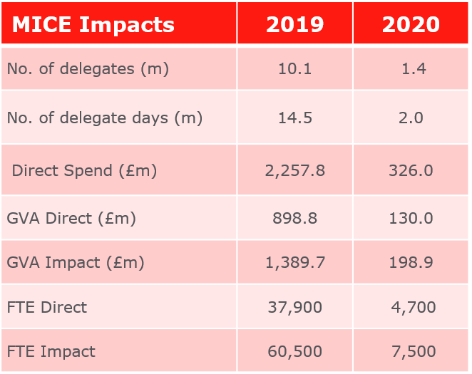
Literature Review – Visitor Economy
The West Midlands MICE Impact report estimated the consciderable economic impact of Meetings, Incentives, Conferences and Exhibitions (MICE) in the West Midlands
West Midlands MICE Impact
This report provided an estimate of the economic impact of Meetings, Incentives, Conferences and Exhibitions (MICE) in the West Midlands.
This study provided a baseline of the impact of MICE to the region. The baseline year is 2019 – i.e. the last year when business events were not disrupted or restricted by the Covid-19 pandemic. This was to be used to feed into the BATP programme evaluation and help assess the additionality of the programme. This report also provides data on the impact in 2020.
MICE, in the 2019 baseline year, generated:
10.1 million visits to the region. These equated to 14.5m delegate / visitor days.
£2.2 billion of direct of spend which translated into £898.8m of GVA.
37,900 FTEs.
With indirect and induced multipliers (see Glossary – appendix 2), total impacts were:
£1.39 billion of GVA, and
60,500 FTEs.
MICE was particularly badly hit by the Covid-19 pandemic with closure of the conference and exhibition sectors from early/mid March 2020.
Small meetings (less than 30 people) were permitted in the summer of 2020 under certain circumstances but were restricted throughout the rest of the year. Incentive travel was impacted by international travel restrictions, lockdowns and consumer confidence.
Source: West Midlands Combined Authority Document: West Midlands MICE Impact

Slide 32
Literature Review – Visitor Economy
The STEAM WM Summary 2022 / The Economic Impact of the Visitor Economy 2021 measured the bounce back in the West Midlands visitor economy
The Economic Impact of the Visitor Economy 2021
Region’s visitor economy bounced back fast with its 2021 sector impact less than 23% down on 2019 level of economic value. West Midlands Combined Authority (WMCA) region’s visitor economy was worth £10.13 billion in 2021, up 78% on the previous year. Further analysis shows that the accommodation sector (including serviced and non-serviced accommodation) has experienced the highest growth – up by 95% compared with 2020.
The breakdown by category of expenditure highlights the wider impact of the tourism sector on the region’s economy. Almost half (47%) of spending was on shopping, 20% on food and drink, 13% on recreation activities, 12% on transport and 8% on accommodation
Region’s visitor numbers were heavily influenced by social contact restrictions The region attracted more than 102 million visitors in 2021 - an increase of 42.91 million visitors on 2020. This represents a 72.3% increase over the last 12 months. Visitor numbers have been growing steadily for a number of years before the pandemic, from 122.42 million in 2016 to 133.89 million in 2019. Visitor volume was sharply down in 2020 due to the impact of Covid-19.
Summer was the most popular season. With more than 13 million visitors, the number peaked in August. The region attracted more visitors in July and August than any other months of the year. Visitor volume was heavily influenced by various social contact restrictions last year - no indoor mixing between different households was allowed until July and visitor attractions were only allowed to open in April.
Source: West Midlands Combined Authority Document: STEAM WM Summary 2022 / The Economic Impact of the Visitor Economy 2021

Slide 33
Literature Review – Visitor Economy
Further Visitor Economy analysis in the Evaluation of the 2022 Commonwealth Games BATP programme – Component 2 Visitor Survey saw visitors surveyed on perceptions.
Evaluation of the 2022 Commonwealth Games BATP programme – Component 2 Visitor Survey
Key Messages: Visitor Profile
While 59% of visitors were from within the region and 74% were day visitors, a healthy proportion were in categories which tend to spend more per head and have a greater economic impact:
35% were from other parts of the UK.
6% were from overseas, and a quarter of these were from BATP target markets.
26% were overnight visitors.
Nearly 60% of these stayed in serviced accommodation such as hotels and B&Bs. While nearly half stayed in Birmingham the economic benefit was spread across the region with 19% staying in Warwickshire, 8% in Coventry and another 8% in Northern Worcestershire and Southern Staffordshire.
50% of visitors stated that they visited the West Midlands instead of going somewhere else in the UK, with 54% visiting now instead of at another time in 2022.
Key Messages: Expenditure
Spend per head for both overseas (£305) and overnight visitors (£303) was more than double the average for all visitors (£143).
Spend per head was highest among visitors to Coventry (£192), Warwickshire (£174) and Birmingham (£164).
Key Messages: Motivation to visit and the impact of BATP marketing campaigns
Nearly 30% of both UK and overseas visitors said that they had seen the BATP marketing campaigns.
The level of recognition peaked among visitors at games time.
Of these 9% of UK-based visitors and 14% of overseas visitors said that the campaigns had motivated them to come to the region.
Campaign recognition was good in all local authority areas across the region and in most areas an encouraging proportion said that the campaigns had motivated them to visit.
Key Messages: Perceptions
Some 88% of visitors to the region rate warmth of welcome as good.
Half would recommend the region to friends and family, rising to 65% among overseas visitors.
Nearly 90% of visitors are likely to return.
Source: West Midlands Combined Authority Document: Component 2 – Visitor Study / Evaluation of the 2022 Commonwealth Games BATP programme

Slide 34
Literature Review – Visitor Economy
The de Bois review of Destination Management Organisations in England, commissioned by DCMS may see high level changes for DMOs across England.
The de Bois review
The de Bois review of Destination Management Organisations in England, commissioned by DCMS , the review examined and assessed how Destination Management Organisations (DMOs) across England are funded and structured, and how they perform their roles, in order to establish whether there may be a more efficient and effective model for supporting English tourism at the regional level, and if so what that model may be.
The recommendations of the review include:
The Government should bring coherence to England’s DMO landscape via a tiering approach, using an accreditation process to create a national portfolio of high performing DMOs that meet certain criteria.
As it is England’s National Tourist Board, with the statutory responsibility for growing tourism at an England level, the Government should charge VisitEngland with responsibility for creating, maintaining and supporting this new tiered structure. It should receive sufficient funding and resources to do this.
As responsibility for tourism policy cuts across multiple departments, creating a confusing picture, practical measures to address these issues could include elevating the Tourism Minister to a Minister of State position and either reallocating responsibilities from other departments to sit under that Minister or making the Minister responsible for the activities of teams within multiple departments.
To help DMOs and Local Authorities take decisions on how best to develop the visitor economy in their local area, the Government should improve access to quality data by introducing the proposed Tourism Data Hub as a matter of urgency.
Source: West Midlands Combined Authority Document: Component 2 – Visitor Study / Evaluation of the 2022 Commonwealth Games BATP programme

Slide 35
Literature Review – Investment
text
Potential Gaps in Supplied Literature
Needs long term tourism strategy to increase the length of stay in the WMCA, and increase the spend.
Integration of MICE strategy into investment and trade strategy – already in WMCA…,, local research talent etc
Consideration of WMCA unique experiential assets
Consideration of what is distinctly “Black Country” etc.
Consideration of local, participatory, unique experiences – that engage all the senses (not just sight, hearing).
Embedding longer term consumer sentiment analysis
Tourism skills programme
Development of longer term marketing campaigns and toolkits

Slide 36
CHALLENGE.
CREATE.
COLLABORATE.
OCOglobal.com

